Slide 1
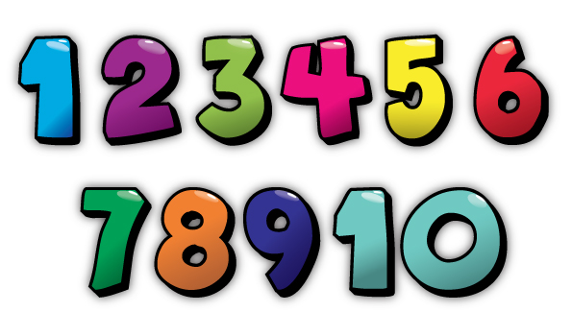
Chesters Nursery School
Play A Long Maths Programme

Slide 2
Aims of Programme
To help develop your child’s skills with number and maths before going to school.
Improve problem solving skills.
To use more mathematical language(e.g. more than, less than).
Encourage parents to be more confident with number and maths.
Use number resources at home in a fun way.

Slide 3
How?
Choose new resources each week, that concentrate on;
Number
Sequencing
Colour
Shape
Pattern
Time

Slide 4
Parental Participation
6 Week programme.
Drop in sessions to collect and drop off activity bags.
Complete weekly diary.
Email in a photograph.
Short discussion at end of programme to discuss the benefits.

Slide 5
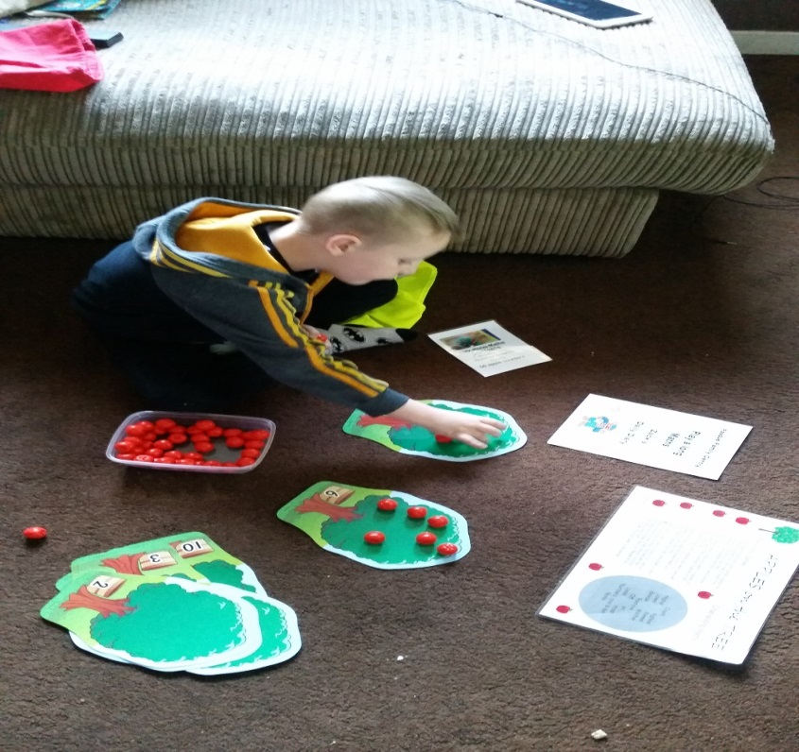
fun

